Slide 1







Source Control Systems
SVN, Git, GitHub
Teamwork and
Personal Skills
SoftUni Team
Technical Trainers
Software University
http://softuni.bg

Slide 2

Table of Contents
Software Configuration Management (SCM)
Version Control Systems: Philosophy
Versioning Models
Lock-Modify-Unlock
Copy-Modify-Merge
Distributed Version Control
Tags and Branching
Subversion, Git – Demo
Project Hosting Sites

Slide 3
Software Configuration Management (SCM)
Version Control ≈ Software Configuration Management (SCM)
A software engineering discipline
Consists of techniques, practices and tools for working on shared source code and files
Mechanisms for management, control and tracking the changes
Defines the process of change management
Keeps track of what is happening in the project over the time
Solves conflicts in the changes

Slide 4
SCM and the Software Development Lifecycle
Release
The Final
Product
Analysis
Testing
Text
Scripts
and Data
Requirements
SCM
Build
Scripts,
Final
Product
Models
Build
Design
Source Code
Implementation

Slide 5

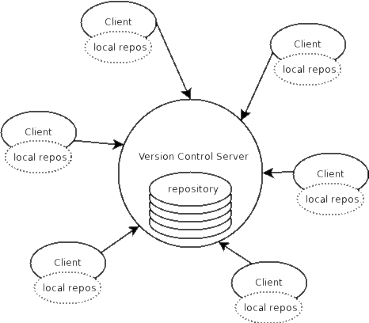

Version Control
Managing Different Versions of the Same File / Document

Slide 6

Version Control Systems (VCS)
Functionality
File versions control
Merge and differences search
Branching
File locking
Console and GUI clients
Well known products
CVS, Subversion (SVN) – free, open source
Git, Mercurial – distributed, free, open source
Perforce, Microsoft TFS – commercial

Slide 7
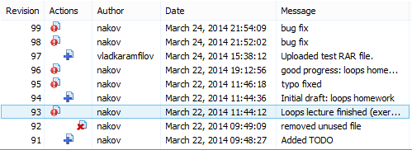
Version Control (Revision Control)
Constantly used in software engineering
During the software development
While working with documents
Changes are identified with an increment of the version number
for example 1.0, 2.0, 2.17
Version numbers are historically linked with the person who created them
Full change logs are kept

Slide 8
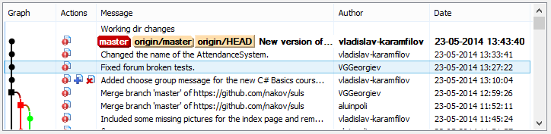
Change Log
Systems for version control keep a complete change log (history)
The date and hour of every change
The user who made the change
The files changed + old and new version
Old versions can be retrieved, examined and compared
It is possible to return to an old version (revert)

Slide 9
Vocabulary
Repository (source control repository)
A server that stores the files (documents)
Keeps a change log
Revision, Version
Individual version (state) of a document that is a result of multiple changes
Check-Out, Clone
Retrieves a working copy of the files from a remote repository into a local directory
It is possible to lock the files

Slide 10
Vocabulary (2)
Change
A modification to a local file (document) that is under version control
Change Set / Change List
A set of changes to multiple files that are going to be committed at the same time
Commit, Check-In
Submits the changes made from the local working copy to the repository
Automatically creates a new version
Conflicts may occur!

Slide 11
Vocabulary (3)
Conflict
The simultaneous change to a certain file by multiple users
Can be solved automatically and manually
Update, Get Latest Version, Fetch / Pull
Download the latest version of the files from the repository to a local working directory + merge conflicting files
Undo Check-Out, Revert / Undo Changes
Cancels the local changes
Restores their state from the repository

Slide 12
Vocabulary (4)
Merge
Combines the changes to a file changed locally and simultaneously in the repository
Can be automated in most cases
Label / Tag
Labels mark with a name a group of files in a given version
For example a release
Branch / Branching
Division of the repositories in a number of separate workflows

Slide 13

Version Control: Typical Scenario
Users
Repository
Main
development
line (trunk)
User X
Version A Branch
Version A.1 Branch
Check Out
Check In
C
A
User Y
B
Version B Branch
Check Out
D
Merge
E
Check In

Slide 14

Subversion
Using Subversion and TortoiseSVN

Slide 15
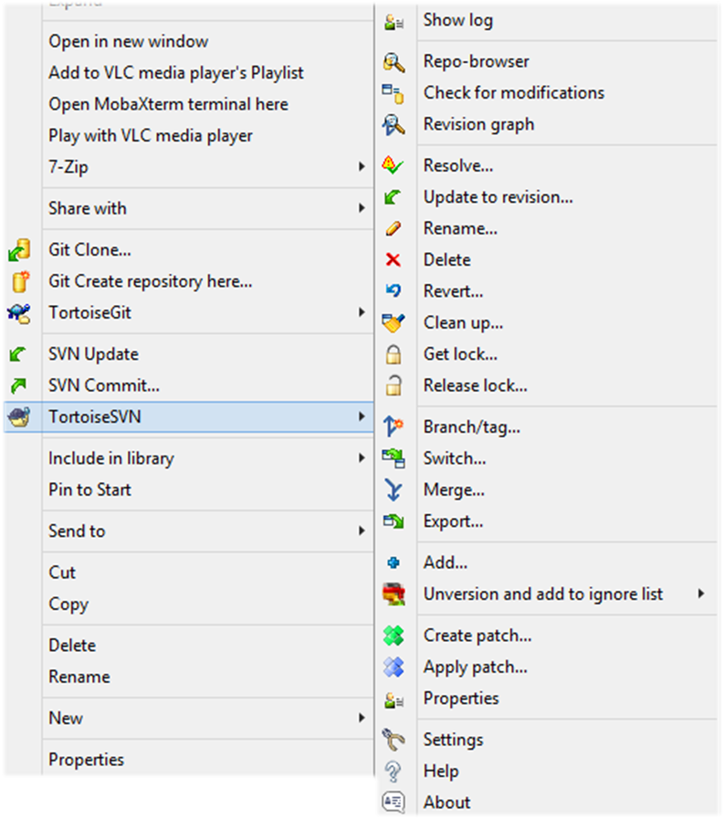
Subversion (SVN)
Subversion (SVN)
Open source SCM repository
http://subversion.tigris.org
Runs on Linux, Windows, Mac OS
Console client
svn
GUI client – TortoiseSVN
http://tortoisesvn.tigris.org
Visual Studio / Eclipse plug-ins

Slide 16
Subversion – Features
Versioning of the directory structure
Complete change log
Deletion of files and directories
Renaming of files and directories
Saving of files or directories
Can work on it’s own or integrated with Apache as a module
Simple to use, based on central SVN repository
Works effectively with tags and branches

Slide 17
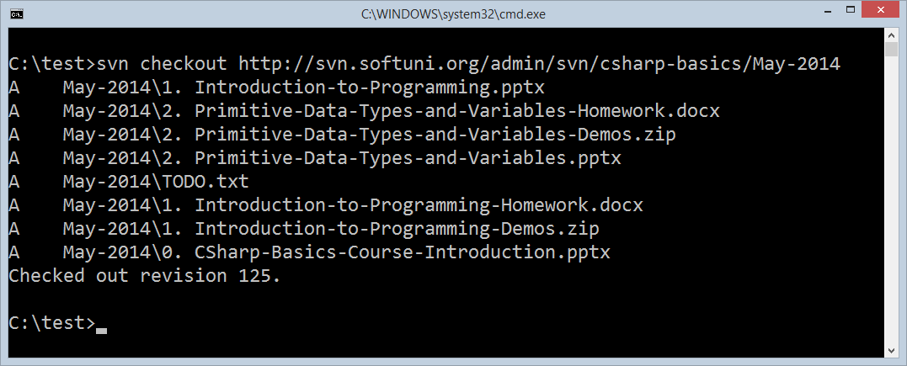
SVN – Console Client

Slide 18
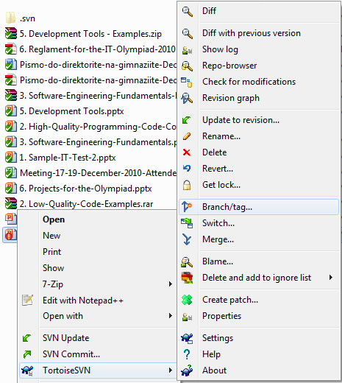
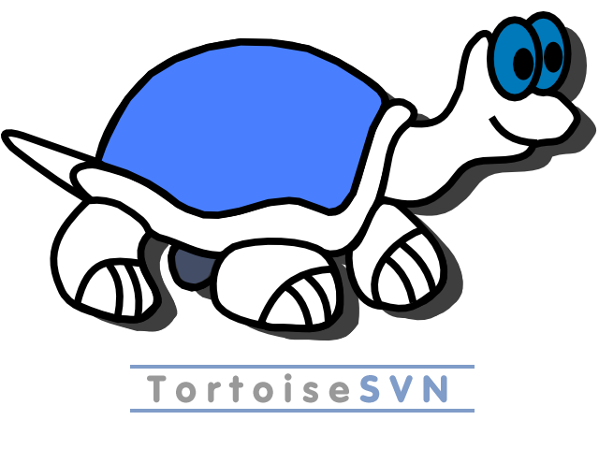
TortoiseSVN
TortoiseSVN
Open source GUI client for Subversion for Windows
Integrated in Windows Explorer
http://tortoisesvn.tigris.org

Slide 19


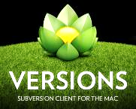
Subversion & TortoiseSVN
Live Demo

Slide 20
SVN: Exercise
Checkout the SVN repository:
https://github.com/SoftUni/test/trunk
Make some local changes (add / edit files)
Commit your changes to the SVN server
Create a conflict and resolve it

Slide 21
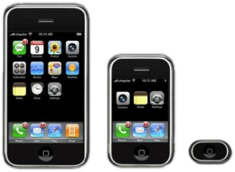
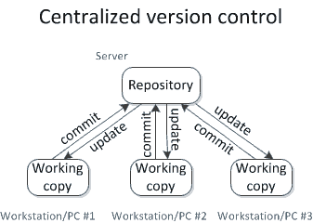
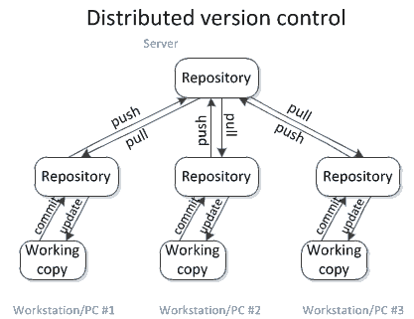

Versioning Models
Lock-Modify-Unlock, Copy-Modify-Merge, Distributed Version Control

Slide 22
Centralized Version Control
Source: http://homes.cs.washington.edu/~mernst/advice/version-control.html

Slide 23
Distributed Version Control
Source: http://homes.cs.washington.edu/~mernst/advice/version-control.html

Slide 24

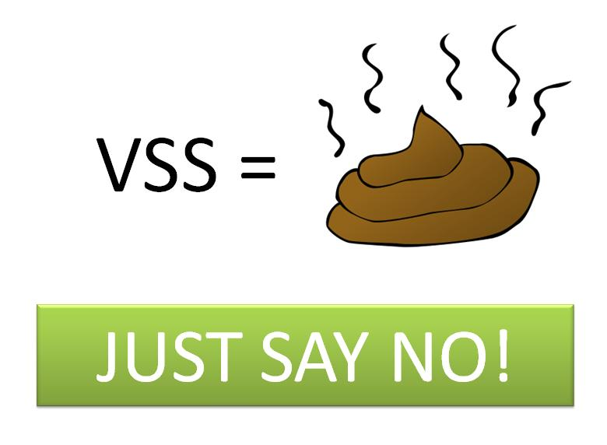
Versioning Models
Lock-Modify-Unlock
Only one user works on a given file at a time
No conflicts occur
Users wait each other for the locked files → works for small development teams only
Pessimistic concurrency control
Examples:
Visual SourceSafe (VSS) – old fashioned
SVN, Git, TFS (with exclusive locking)
Lock-modify-unlock is rarely used

Slide 25



Versioning Models (2)
Copy-Modify-Merge
Users make parallel changes to their own working copies
Conflicts are possible when multiple user edit the same file
Conflicting changes are merged and the final version emerges (automatic and manual merge)
Optimistic concurrency control
Examples:
SVN, Git, TFS

Slide 26


Versioning Models (3)
Distributed Version Control
Users work in their own repository
Using the Lock-Modify-Unlock model
Local changes are locally committed
No concurrency, no local conflicts
From time to time, the local repository is pushed to the central repository
Conflicts are possible and merges often occur
Example of distributed version control systems:
Git, Mercurial

Slide 27


Problems with Locking
Administrative problems:
Someone locks a given file and forgets about it
Time is lost while waiting for someone to release a file → works in small teams only
Unneeded locking of the whole file
Different changes are not necessary in conflict
Example of non-conflicting changes:
Andy works at the begging of the file
Bobby works at the end of the file

Slide 28

Merging Problems
When a file is concurrently modified, changes should be merged
Merging is hard!
It is not always automatic process
Coordination and responsibility between the developers is required
Commit changes as early as finished
Do not commit code that does not compile or blocks the work of the others
Leave meaningful comments at each commit

Slide 29
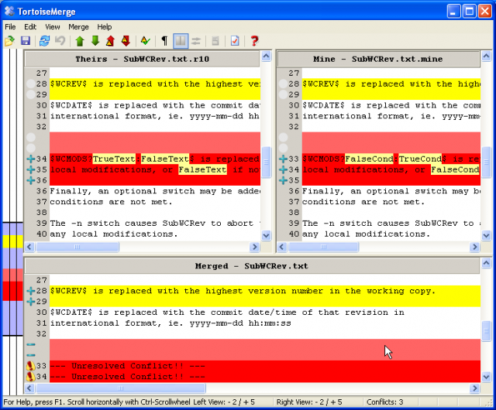
File Comparison / Merge Tools
During manual merge use file comparison
There are visual comparison / merge tools:
TortoiseMerge
WinDiff
AraxisMerge
WinMerge
BeyondCompare
CompareIt
…

Slide 30
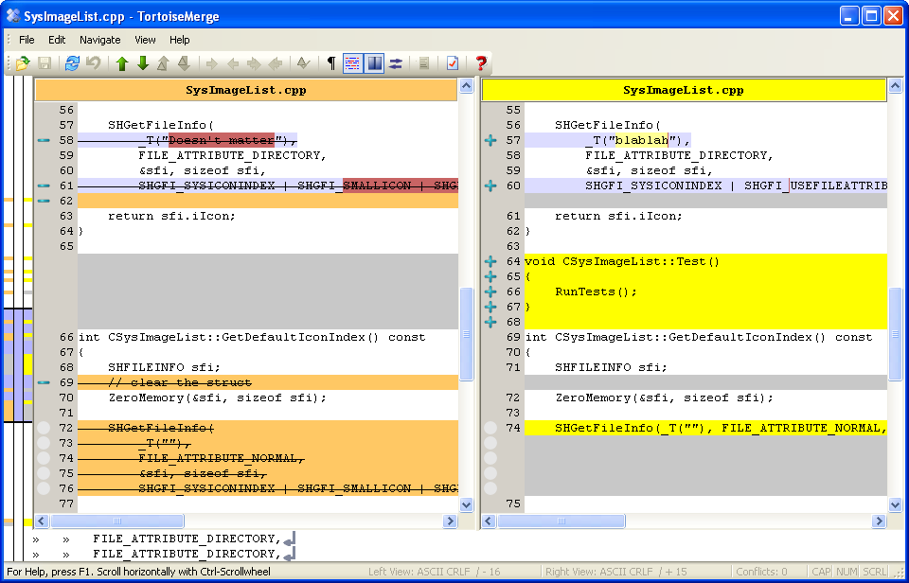
File Comparison – Example

Slide 31




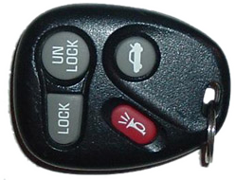
The "Lock-Modify-Unlock" Model

Slide 32

The Lock-Modify-Unlock Model (1)
Andy and Bobby check-out file A.
The check-out is done without locking. They just get a local copy.
Repository
A
Check-out
Check-out
A
A
Bobby
Andy

Slide 33
The Lock-Modify-Unlock Model (2)
Repository
Andy locks file A and begins modifying it.
A
Lock
A
Аndy
(Local Edit)
Bobby
Andy

Slide 34

The Lock-Modify-Unlock Model (3)
Bobby tries to lock the file too, but she can’t.
Bobby waits for Andy to finish and unlock the file.
Repository
A
Wait
A
Andy
Bobby
Andy

Slide 35
The Lock-Modify-Unlock Model (4)
Repository
Andy commits his changes and unlocks the file.
Andy
Commit
A
Andy
Bobby
Andy

Slide 36
The Lock-Modify-Unlock Model (5)
Now Bobby can take the modified file and lock it.
Bobby edits her local copy of the file.
Repository
Andy
Lock
Andy
Andy
(Local Edit)
Bobby
Andy

Slide 37
The Lock-Modify-Unlock Model (6)
Bobby finishes, commits her changes and unlocks the file.
Repository
Andy
Bobby
Commit
Andy
Bobby
Andy
Bobby
Andy

Slide 38
The Lock-Modify-Unlock Model (7)
Andy updates the changes from the repository.
Repository
Andy
Bobby
Update
Andy
Bobby
Andy
Bobby
Bobby
Andy

Slide 39
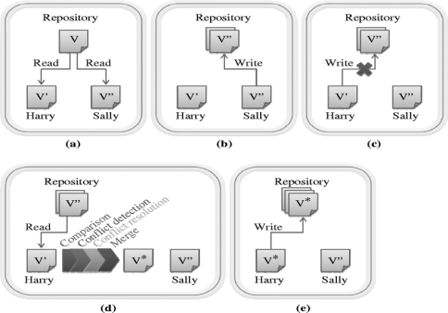

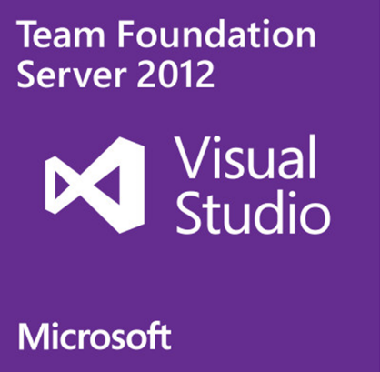
The "Copy-Modify-Merge" Model

Slide 40
The Copy-Modify-Merge Model (1)
Andy and Bobby check-out a file A.
The check-out is done without locking.
Repository
A
Check-out
Check-out
A
A
Bobby
Andy

Slide 41
The Copy-Modify-Merge Model (2)
Both of them edit the local copies of the file (in the same time).
Repository
A
Bobby
Andy
(Local Edit)
(Local Edit)
Bobby
Andy

Slide 42
The Copy-Modify-Merge Model (3)
Bobby commits her changes to the repository.
Repository
Bobby
Commit
Bobby
Andy
Bobby
Andy

Slide 43
The Copy-Modify-Merge Model (4)
Andy tries to commit his changes.
A conflict occurs.
Repository
Bobby
Commit
Bobby
Bobby
Andy
Andy
(Local Conflict)
Bobby
Andy

Slide 44
The Copy-Modify-Merge Model (5)
Andy updates his changes with the ones from the repository.
The changes merge into his local copy.
A merge conflict can occur.
Repository
Bobby
Update
(with merge)
Bobby
Andy
&
Bobby
(Local Merge)
Bobby
Andy

Slide 45
The Copy-Modify-Merge Model (6)
Andy commits the merged changes to the repository.
A common version with the changes of Andy and Bobby is inserted.
Repository
Andy
&
Bobby
Commit
Bobby
Andy
&
Bobby
Bobby
Andy

Slide 46
The Copy-Modify-Merge Model (7)
Bobby updates the changes from the repository.
She gets the common version with both changes from Andy and Bobby.
Repository
Andy
&
Bobby
Update
Andy
&
Bobby
Andy
&
Bobby
Bobby
Andy

Slide 47

The "Distributed Version Control" Versioning Model

Slide 48

Distributed Version Control (1)
Andy and Bobby clone the remote repository locally.
They both have the same files in their local repositories.
Remote Repository (Server)
A
Clone
Clone
A
A
Local Repository
(Andy)
Local Repository
(Bobby)
Andy
Bobby

Slide 49
Distributed Version Control (2)
Remote Repository (Server)
Andy and Bobby work locally on a certain file A.
A
(Local Edit)
(Local Edit)
Andy
A
A
Bobby
Local Repository
(Andy)
Local Repository
(Bobby)
Andy
Bobby

Slide 50
Distributed Version Control (3)
Andy and Bobby commit locally the modified file A into their local repositories.
Remote Repository (Server)
A
Commit (locally)
Commit (locally)
Andy
Andy
Bobby
Bobby
Local Repository
(Andy)
Local Repository
(Bobby)
Andy
Bobby

Slide 51
Distributed Version Control (4)
Andy pushes the file A to the remote repository.
Still no conflicts occur.
Remote Repository (Server)
Andy
Push
Andy
Andy
Bobby
Bobby
Local Repository
(Andy)
Local Repository
(Bobby)
Andy
Bobby

Slide 52
Distributed Version Control (5)
Bobby tries to push her changes.
A versioning conflict occurs.
Remote Repository (Server)
Andy
Push (conflict)
Andy
Andy
Bobby
Bobby
Local Repository
(Andy)
Local Repository
(Bobby)
Andy
Bobby

Slide 53
Distributed Version Control (6)
Bobby merges the her local files with the files from the remote repository.
Conflicts are locally resolved.
Remote Repository (Server)
Andy
Pull (Fetch + Merge)
Andy
Andy
Bobby
+Andy
Bobby
+Andy
Local Repository
(Andy)
Local Repository
(Bobby)
Andy
Bobby

Slide 54
Distributed Version Control (7)
Remote Repository (Server)
Bobby commits her merged changes.
No version conflict.
Bobby
+Andy
Andy
Push (no conflict)
Andy
Andy
Bobby
+Andy
Bobby
+Andy
Local Repository
(Andy)
Local Repository
(Bobby)
Andy
Bobby

Slide 55
Distributed Version Control (8)
Andy pulls (updates) the changed files from the remote repository.
Remote Repository (Server)
Bobby
+Andy
Andy
Pull
Bobby
+Andy
Bobby
+Andy
Bobby
+Andy
Bobby
+Andy
Local Repository
(Andy)
Local Repository
(Bobby)
Andy
Bobby

Slide 56


Tags and Branches

Slide 57
Tags
Allows us to give a name to a group of files in a certain version
File A
1.1
1.2
1.3
1.4
Tag "Beta 2"
File B
1.1
1.2
File C
1.1
1.2
1.3

Slide 58
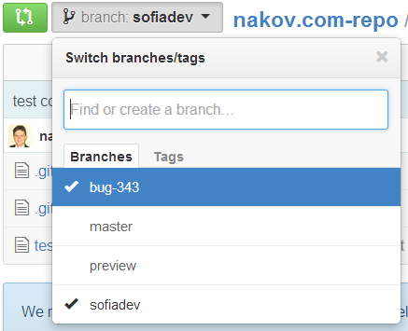
Branching
Branching allows splitting the development line into separate branches
Different developers work in different branches
Branching is suitable for:
Development of new feature or fix in a new version of the product (for example version 2.0)
Features are invisible in the main development line
Until merged with it
You can still make changes in the older version (for example version 1.0.1)

Slide 59
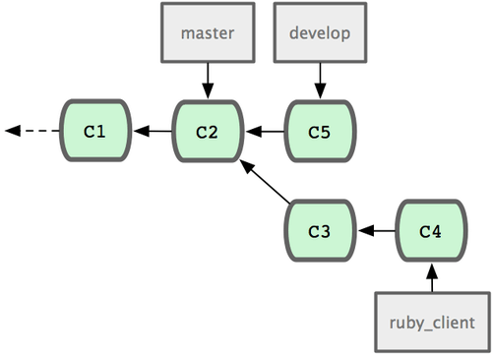
Merging Branches
Some companies work in separate branches
For each new feature / fix / task
Once a feature / fix / task is completed
It is tested locally and committed in its branch
Finally it is merged into the main development line
Merging is done locally
Conflicts are resolved locally
If the merge is tested and works well, it is integrated back in the main development line

Slide 60
Branching – Example
Branch 1.2.2.2.2 ->
1.2.2.2.2.1
1.2.2.2.2.2
Branch 1.2.2. ->
1.2.2.1
1.2.2.2
1.1
1.2
1.3
1.4
Main trunk
(remote master)
File A
Branch 1.2.4. ->
1.2.4.1
1.2.4.2
1.2.4.3

Slide 61
Merging Branches – Example
Branch 1.2.2.2.2 ->
1.2.2.2.2.1
1.2.2.2.2.2
Branch 1.2.2. ->
1.2.2.1
1.2.2.2
Main trunk
(remote master)
1.1
1.2
1.3
1.4
1.5
File A
Branch 1.2.4. ->
1.2.4.1
1.2.4.2
1.2.4.3

Slide 62
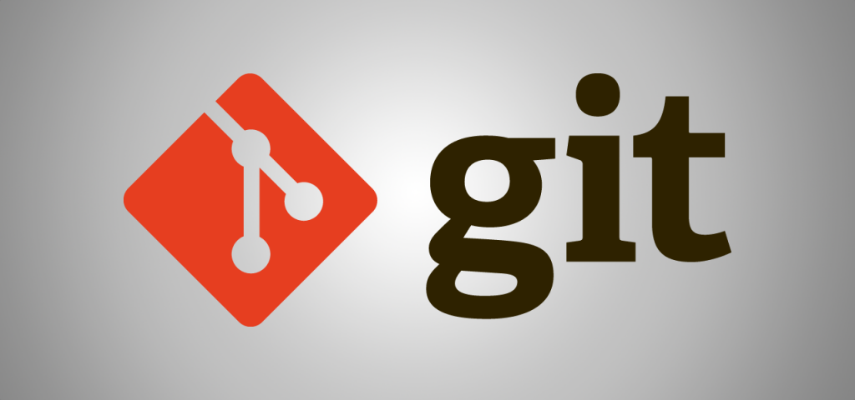
Working with Git

Slide 63

What is Git?
Git
Distributed source-control system
Work with local and remote repositories
Git bash – command line interface for Git
Free, open-source
Has Windows version (msysGit)
http://msysgit.github.io
https://www.atlassian.com/git/tutorials/setting-up-a-repository

Slide 64
Installing Git
msysGit Installation on Windows
Download Git for Windows from: http://msysgit.github.io
“Next, Next, Next” does the trick
Options to select (they should be selected by default)
“Use Git Bash only”
“Checkout Windows-style, commit Unix-style endings”
Git installation on Linux:
sudo apt-get install git

Slide 65
Basic Git Commands
Cloning an existing Git repository
Fetch and merge the latest changes from the remote repository
Preparing (adding / selecting) files for a commit
Committing to the local repository
git clone [remote url]
git pull
git add [filename] ("git add ." adds everything)
git commit –m "[your message here]"

Slide 66
Basic Git Commands (2)
Check the status of your local repository (see the local changes)
Creating a new local repository (in the current directory)
Creating a remote (assign a short name for remote Git URL)
Pushing to a remote (send changes to the remote repository)
git status
git init
git remote add [remote name] [remote url]
git push [remote name] [local name]

Slide 67
Using Git: Example
mkdir work
cd work
git clone https://github.com/SoftUni/test.git
dir
cd test
dir
git status
(edit some file)
git status
git add .
git commit -m "changes"
git push

Slide 68



Using Git Bash
Live Demo

Slide 69

TortoiseGit
Using the Windows GUI Git Client – Live Demo

Slide 70

Project Hosting and Team Collaboration Sites
GitHub, SourceForge, Google Code, CodePlex, Project Locker

Slide 71
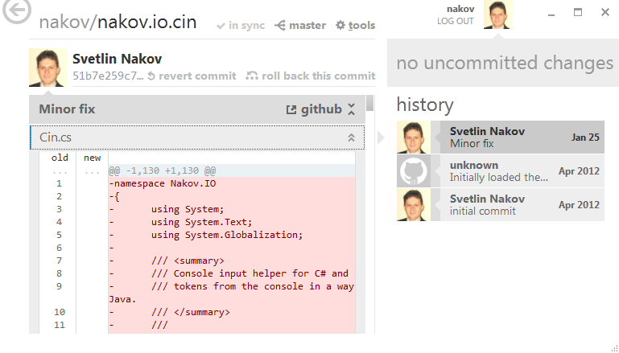
Project Hosting Sites
GitHub – https://github.com
The #1 project hosting site in the world
Free for open-source projects
Paid plans for private projects
GitHub provides own Windows client
GitHub for Windows
http://windows.github.com
Dramatically simplifies Git
For beginners only

Slide 72
Project Hosting Sites
Google Code – http://code.google.com/projecthosting/
Source control (SVN), file release, wiki, tracker
Very simple, basic functions only, not feature-rich
Free, all projects are public and open source
1-minute signup, without heavy approval process
SourceForge – http://www.sourceforge.net
Source control (SVN, Git, …), web hosting, tracker, wiki, blog, mailing lists, file release, statistics, etc.
Free, all projects are public and open source

Slide 73
Project Hosting Sites (2)
CodePlex – http://www.codeplex.com
Microsoft's open source projects site
Team Foundation Server (TFS) infrastructure
Source control (TFS), issue tracker, downloads, discussions, wiki, etc.
Free, all projects are public and open source
Project Locker – http://www.projectlocker.com
Source control (SVN), TRAC, CI system, wiki, etc.
Private projects (not open source)
Free and paid editions

Slide 74
Project Hosting Sites (3)
Assembla – http://www.assembla.com
Source control (SVN, Git), issue tracker, wiki, chats, files, messages, time tracking, etc.
Private / public projects, free and paid editions
Bitbucket – http://bitbucket.org
Source control (Mercurial), issue tracker, wiki, management tools
Private projects, free and paid editions
Others: Unfuddle, XP-Dev, Beanstalk

Slide 75
GitHub
Live Demo

Slide 76
Git and GitHub: Exercise
Checkout the Git repository:
https://github.com/SoftUni/test
Make some local changes (add / edit files)
Commit your changes locally
Push your changes to GitHub
Create a conflict and resolve it

Slide 77
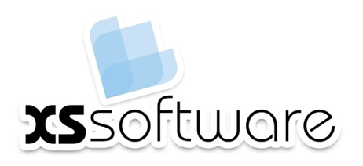









Source Control Systems
https://softuni.bg/courses/teamwork-and-personal-skills/

Slide 78
License
This course (slides, examples, demos, videos, homework, etc.) is licensed under the "Creative Commons Attribution-NonCommercial-ShareAlike 4.0 International" license
Attribution: this work may contain portions from
"Knowledge Sharing and Team Working" course by Telerik Academy under CC-BY-NC-SA license

Slide 79






Free Trainings @ Software University
Software University Foundation – softuni.org
Software University – High-Quality Education, Profession and Job for Software Developers
softuni.bg
Software University @ Facebook
facebook.com/SoftwareUniversity
Software University @ YouTube
youtube.com/SoftwareUniversity
Software University Forums – forum.softuni.bg

